Slide 1
“THEORY OF AUTOMATA”
Context Free Grammar (CFG)

Slide 2
Summary
PDA corresponding to CFG, Examples of PDA corresponding to CFG

Slide 3
PDA corresponding to CFG
Theorem
Corresponding to any CFG there exists a PDA accepting the language generated by the CFG.
Since an algorithm has already been discussed to convert the CFG in CNF, so the PDA can be constructed corresponding to the CFG. As the CFG in CNF generates all the nonnull words of the corresponding CFL, so accepting the null string (if it is contained in the CFL), can be managed separately.

Slide 4
Example
Consider the following CFG which is in CNF and does not generate the null string
S SB|AB
A CC
B b
C a

Slide 5
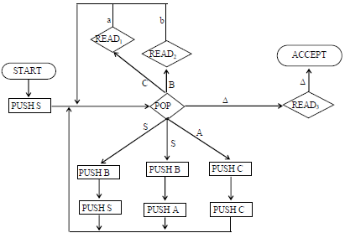

The corresponding PDA will be
Here the STACK alphabet Γ = {S, A, B, C}, where the TAPE alphabet ∑={a, b}

Slide 6

Consider the word aab with its left most derivation, as follows
Working-String Generation Production Used
S AB S AB step 1
CCB A CC step 2
aCB C a step 3
aaB C a step 4
aab B b step 5
First of all the START state is entered

Slide 7



The PUSH S state is entered
The POP state is entered and to accommodate the production S AB, PUSH B and PUSH A states are entered.
Then the POP state is entered and to accommodate the production
A CC, PUSH C, PUSH C states are entered

Slide 8


The POP state is entered and to accommodate the production C→a, READ₁ state is entered and the letter a is read from the TAPE
The POP state is entered and to accommodate the production B→b, READ₂ state is entered and the letter b is read from the TAPE

Slide 9
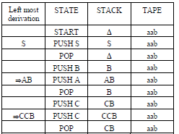
The ∆ shown in the STACK indicates that there are no nonterminals in the working string and ∆ is read from the STACK which leads to READ₃ state where the ∆ is read from the TAPE and the ACCEPT state is entered which shows that the word aab is accepted by the PDA.

Slide 10
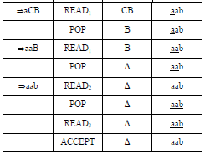
Following is an example of building the PDA corresponding to the given CFG

Slide 11
Example
Consider the following CFG
S → XY
X→ aX | bX |a
Y A Ya | Yb | a
First of all, converting the CFG to be in CNF, introduce the nonterminals A and B as
A → a
B → b
The following CFG is in CNF
S → XY
X → AX | BX |a
Y → YA | YB | a
A → a
B → b

Slide 12
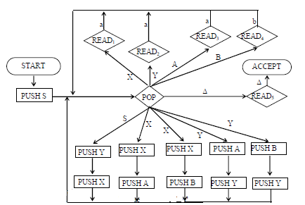
The PDA corresponding to the above CFG will be

Slide 13
The word aaab can be generated as
Working-String Generation Production Used
S ➔ XY S → XY step 1
➔ AXY X → AX step 2
➔ aXY A → a step 3
➔ aaY X → a step 4
➔ aaYB Y → YB step 5
➔ aaaB Y → a step 6
➔ aaab B → b step 7

Slide 14
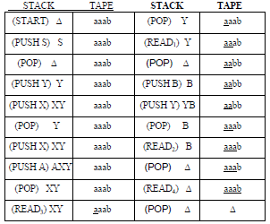

Slide 15
Summary
Recap of example of PDA corresponding to CFG, CFG corresponding to PDA. Theorem, HERE state, Definition of Conversion form, different situations of PDA to be converted into conversion form
Example
Consider the following CFG
S → XY
X → aX | bX |a
Y → Ya | Yb | a
First of all, converting the CFG to be in CNF, introduce the nonterminals A and B as
A → a
B → b

Slide 16
The following CFG is in CNF
S → XY
X → AX | BX |a
Y → YA | YB | a
A → a
B → b

Slide 17
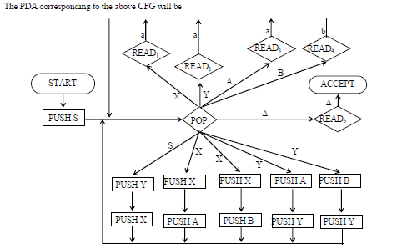

Slide 18
Theorem
Given a PDA that accepts the language L, there exists a CFG that generates exactly L.
Before the CFG corresponding to the given PDA is determined, the PDA is converted into the standard form which is called the conversion form.
Before the PDA is converted into conversion form a new state HERE is defined which is placed in the middle of any edge.

Slide 19


Like READ and POP states, HERE states are also numbered e.g.
becomes

Slide 20
Conversion form of PDA
Definition
A PDA is in conversion form if it fulfills the following conditions:
There is only one ACCEPT state.
There are no REJECT states.
Every READ or HERE is followed immediately by a POP i.e. every edge leading out of any READ or HERE state goes directly into a POP state.
No two POPs exist in a row on the same path without a READ or HERE between them whether or not there are any intervening PUSH states (i.e. the POP states must be separated by READs or HEREs).

Slide 21

All branching, deterministic or nondeterministic occurs at READ or HERE states, none at POP states and every edge has only one label.
Even before we get to START, a “bottom of STACK” symbol $ is placed on the STACK.
If this symbol is ever popped in the processing it must be replaced immediately.
The STACK is never popped beneath this symbol.
Right before entering ACCEPT this symbol is popped out and left.
The PDA must begin with the sequence

Slide 22


The entire input string must be read before the machine can accept the word.
Different situations of a PDA to be converted into conversion form are discussed as follows
To satisfy condition 3,
becomes

Slide 23


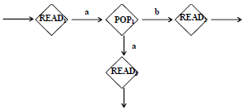
To satisfy condition 4,
becomes
To satisfy condition 5

Slide 24
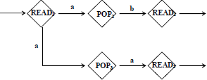

Becomes
To satisfy condition 5

Slide 25
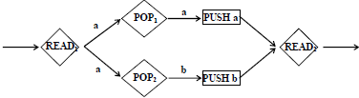

becomes
To satisfy condition 6, it is supposed that the STACK is initially in the position shown below

Slide 26
Summary
Recap of PDA in conversion form, example of PDA in conversion form, joints of the machine, new pictorial representation of PDA in conversion form, summary table, row sequence, row language.

Slide 27
Conversion form of PDA
Definition
A PDA is in conversion form if it fulfills the following conditions:
There is only one ACCEPT state.
There are no REJECT states.
Every READ or HERE is followed immediately by a POP i.e. every edge leading out of any READ or HERE state goes directly into a POP state.
No two POPs exist in a row on the same path without a READ or HERE between them whether or not there are
any intervening PUSH states (i.e. the POP states must be separated by READs or HEREs).

Slide 28

All branching, deterministic or nondeterministic occurs at READ or HERE states, none at POP states and every edge has only one label.
Even before we get to START, a “bottom of STACK” symbol $ is placed on the STACK. If this symbol is ever popped in the processing it must be replaced immediately.
The STACK is never popped beneath this symbol.
Right before entering ACCEPT this symbol is popped out and left.
The PDA must begin with the sequence
The entire input string must be read before the machine can accept the word.

Slide 29
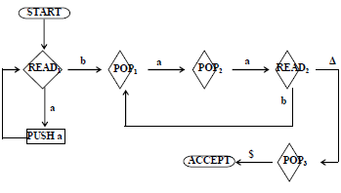
Example
Consider the following PDA accepting the language {a^{2n}b^{n} : n = 1,2,3, ..}

Slide 30
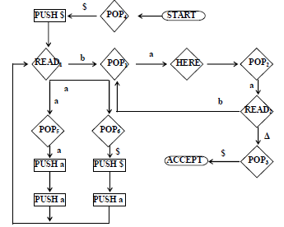
Which may be converted to
The above PDA accepts exactly the same language

Slide 31

Note
It may be noted that any PDA which is in conversion form can be considered to be the collection of path segments, where each path segment is of the following form
START, READ, HERE and ACCEPT states are called the joints of the machine. Between two consecutive joints on a path exactly one character is popped and any number of characters can be pushed. The PDA which is in the conversion form can be supposed to be the set of joints with path segments in between, similar to a TG

Slide 32
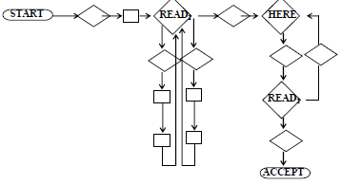
The above entire machine can be described as a list of all joint-to-joint path segments, called summary table. The PDA converted to the conversion form has the following summary table

Slide 33
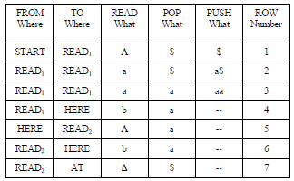
Consider the word aaaabb. This word is accepted by the above PDA through the following path
START-POP4-PUSH$-READ1-POP6-PUSH $-PUSH a-READ1-POP5-PUSH a-PUSH a- READ1- POP5-PUSH a-PUSH a-READ1-POP5-PUSH a-PUSH a-READ1-POP1- HERE-POP2-READ2-POP1- HERE-POP2-READ2-POP3-ACCEPT.

Slide 34
The above path can also be expressed by the following path in terms of sequence of rows
Row1 –Row2 –Row3 –Row3 –Row3 –Row4 –Row5 –Row6 –Row5 –Row7
It can be observed that the above path is not only joint-to-joint consistent but STACK consistent as well.
It may be noted that in FAs, paths correspond to strings of letters, while in PDAs, paths correspond to strings of rows from the summary table.

Slide 35
Note
It may be noted that since the HERE state reads nothing from the TAPE, therefore L is kept in the READ what column.
It may also be noted that the summary table contains all the information of the PDA which is in the pictorial representation. Every path through the PDA is a sequence of rows of the summary table. However, not every sequence of rows from the summary table represents a viable path, i.e. every sequence of rows may not be STACK consistent.
It is very important to determine which sequences of rows do correspond to possible paths through the PDA, because the paths are directly related to the language accepted, e.g. Row4 cannot be immediately followed by Row₆ because Row₄ leaves in HERE, while Row₆ begins in Read₂. Some information must be kept about thee STACK before rows are concatenated.

Slide 36
To represent a path, a sequence of rows must be joint-consistent (the rows meet up end to end) and STACKconsistent (when a row pops a character it should be there at the top of the STACK).
The next target is to define row language whose alphabet is A = {Row1, Row2, …, Row7} i.e. the alphabet consists of the letters which are the names of the rows in the summary table.

Slide 37
Note
It may be noted that the words of the row language trace joint-to-joint and STACK consistent paths, which shows that all the words of this language begin with Row1 and end in Row7. Consider the following row sequence Row5 Row5 Row3 Row6
This is string of 4 letters, but not word of the row language because
It does not represent a path starting from START and ending in ACCEPT state.
It is not joint consistent.
It is not STACK consistent.

Slide 38
Before the CFG that generates the language accepted by the given PDA, is determined, the CFG that generates the row language is to be determined. For this purpose new nonterminals are to be introduced that contain the information needed to ensure joint and STACK consistency.
It is not needed to maintain any information about what characters are read from the TAPE.

Slide 39
LINK
en.wikipedia.org/wiki/Context-free_grammar
www.lri.fr/~genrgens/manual/GRGs-manual-html/node5.html

